Slide 1
Attention Mechanism and Transformer Model
Sisira S R

Slide 2
Contents
Introduction
Large Language Models
Applications of LLMs
Recurrent Network and LSTM
Attention Mechanism
Transformer Model
Conclusion

Slide 3

???

Slide 4


Slide 5
Introduction
A Large Language Model (LLM) is an advanced artificial intelligence system designed to process, understand, and generate human-like text.
Pre-trained using a massive corpus of text data.
The underlying technology of LLMs is called transformer.
Transformer is a neural network architecture in deep learning.

Slide 6
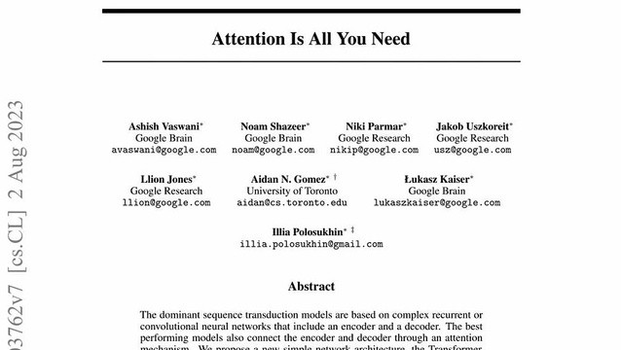
The 2017 paper "Attention Is All You Need" introduced the Transformer model.
This paper transformed the field of AI by introducing a novel architecture based on attention mechanism.

Slide 7
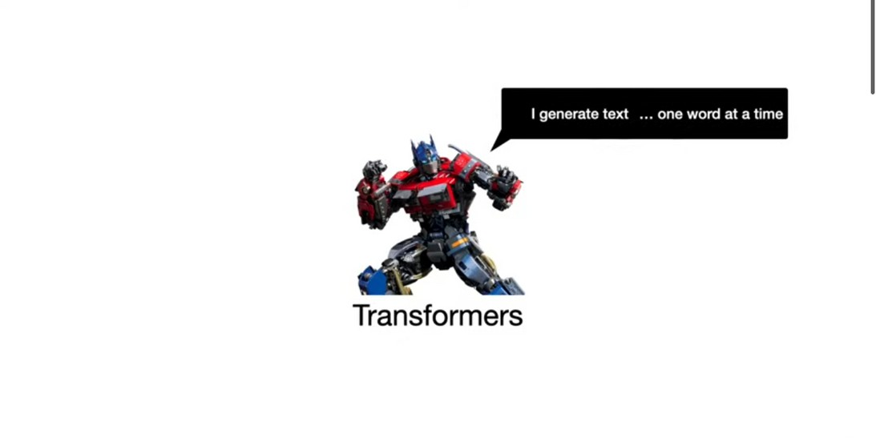

Slide 8
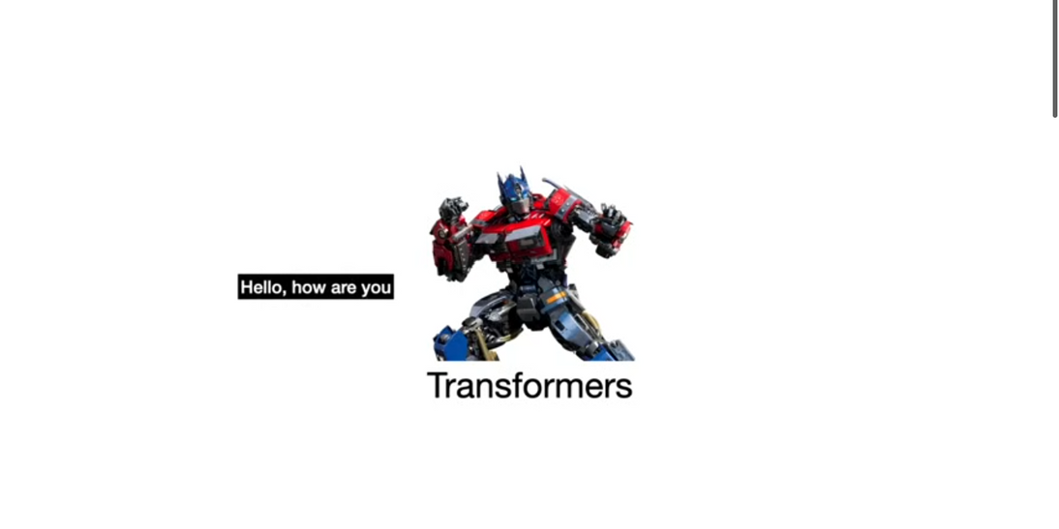

Slide 9
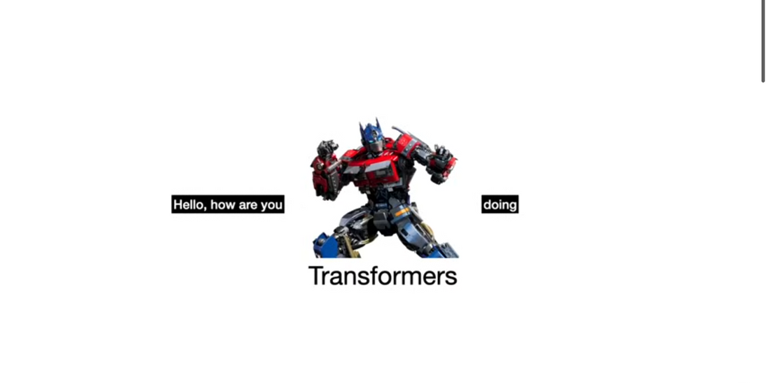

Slide 10
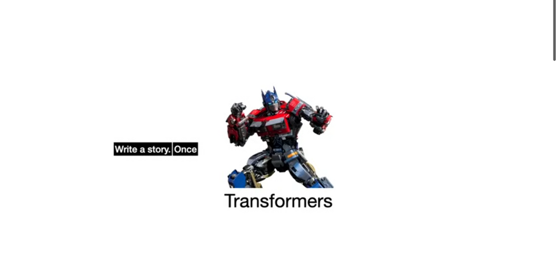

Slide 11
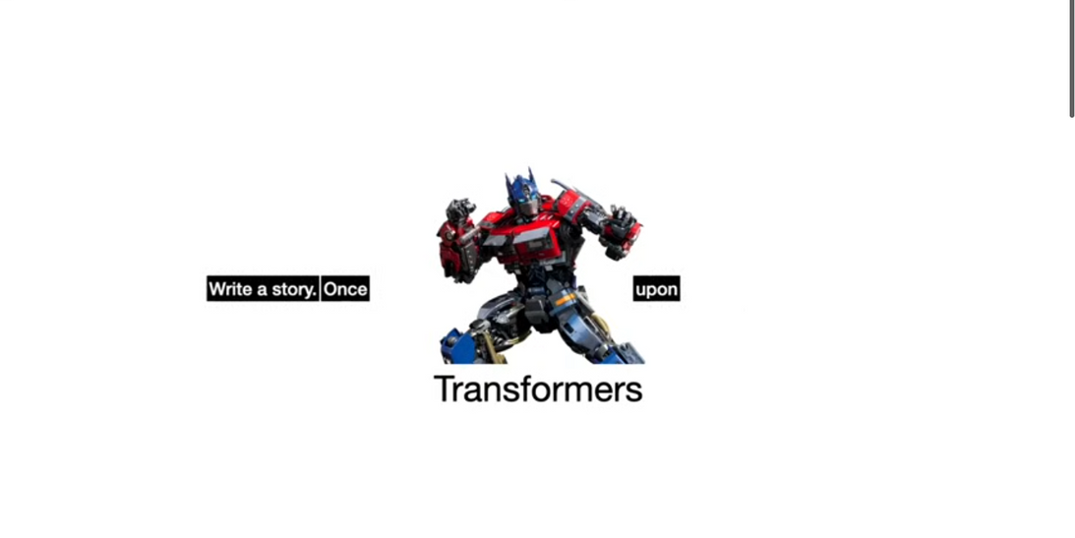

Slide 12
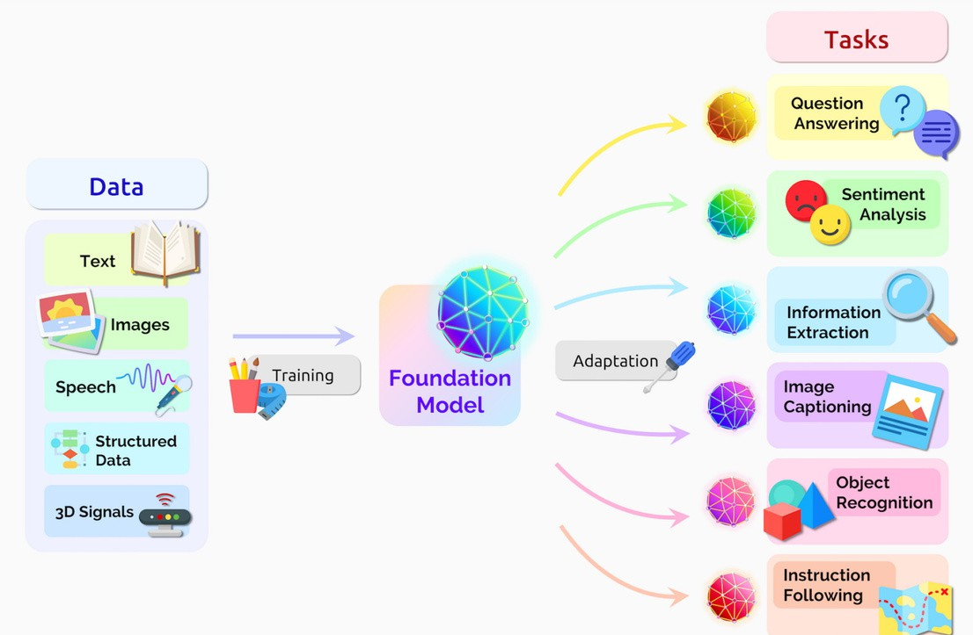

Slide 13
Before Transformers, the dominant models for sequential data were Recurrent Neural Networks (RNNs), such as Long Short-Term Memory (LSTM).

Slide 14
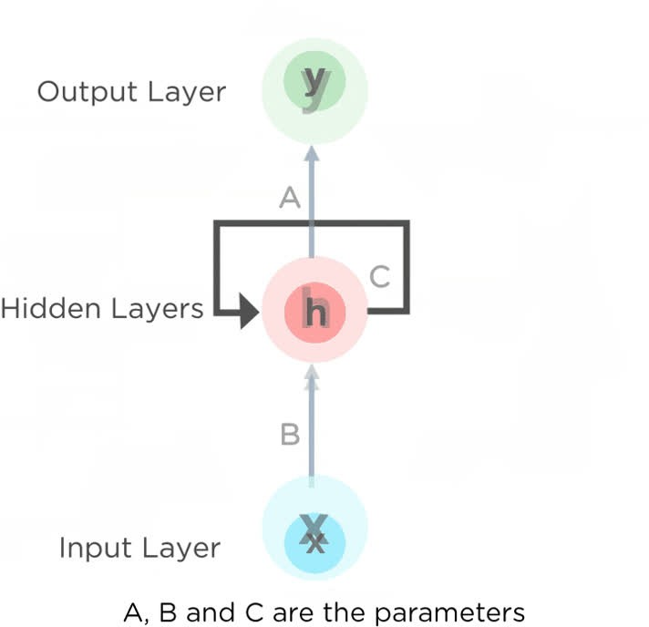
RNNs' problems
Vanishing and Exploding Gradients.
Difficulty with Long-Range Dependencies Sequential Computation
Limited Memory Capacity

Slide 15
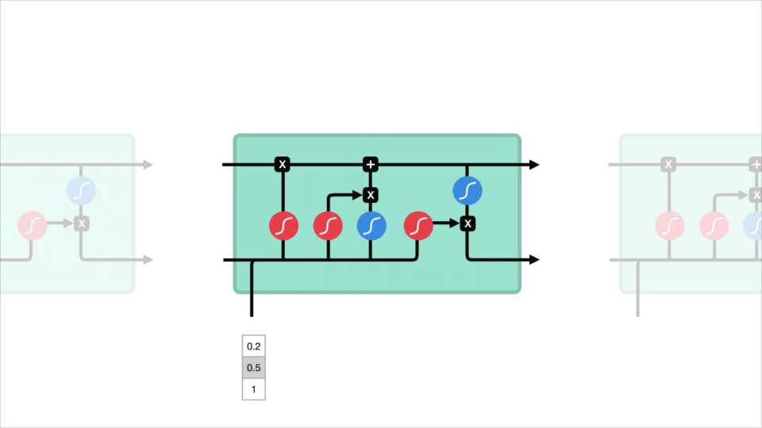
LSTMs problems
Still Sequential
Limited Context Window
Difficulty Scaling to Very Large Datasets Complexity

Slide 16
Main problems
They process the input data sequentially, one after the other.
This makes the training of such models quite slow.
Become ineffective when elements are distant from one another.
Information is passed at each step and the longer the chain is, the more probable the information is lost along the chain.

Slide 17
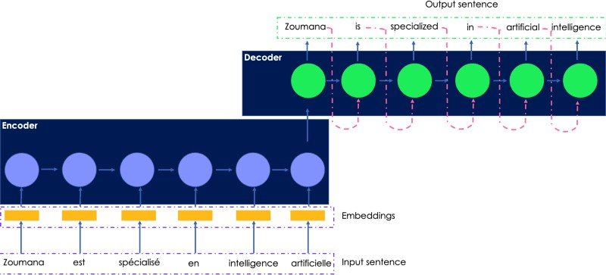

Slide 18
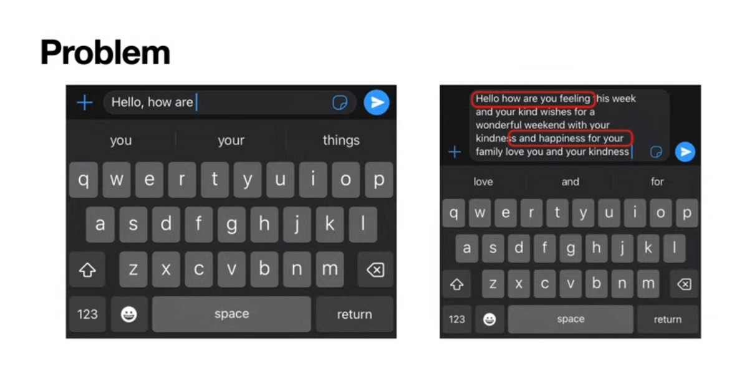

Slide 20
Solution: Attention Mechanism

Slide 21
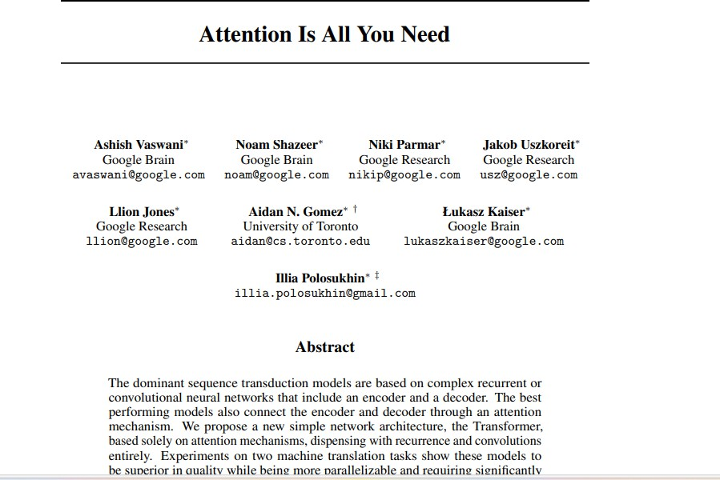

Slide 22
Attention Mechanism
Helps LLMs to understand whole context of the text.

Slide 23
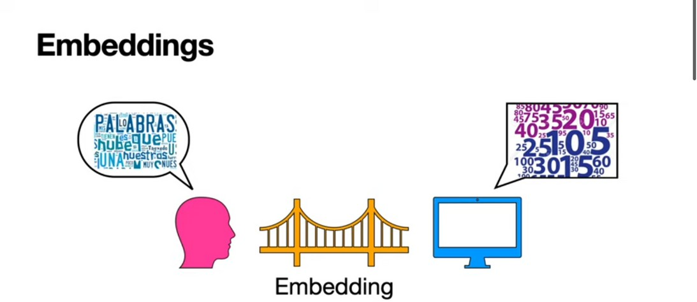

Slide 24
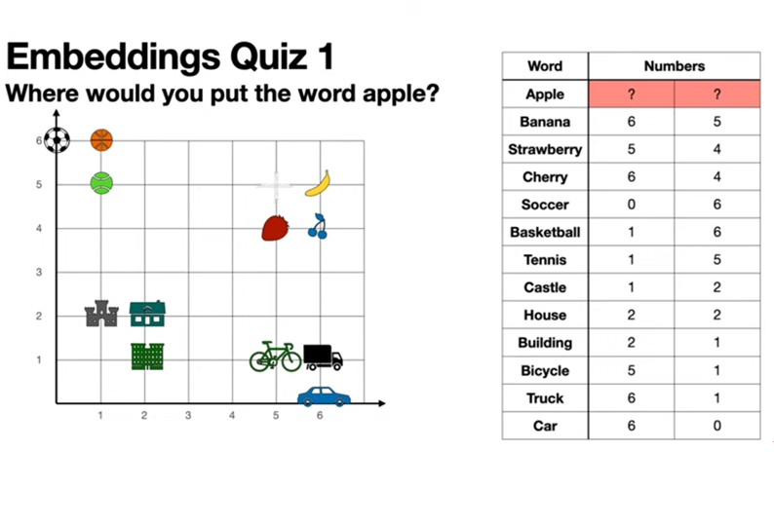

Slide 25
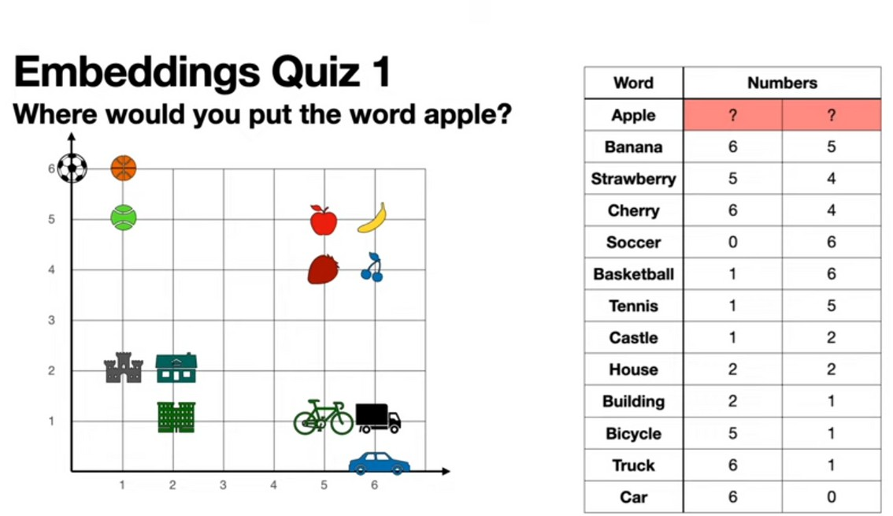

Slide 26
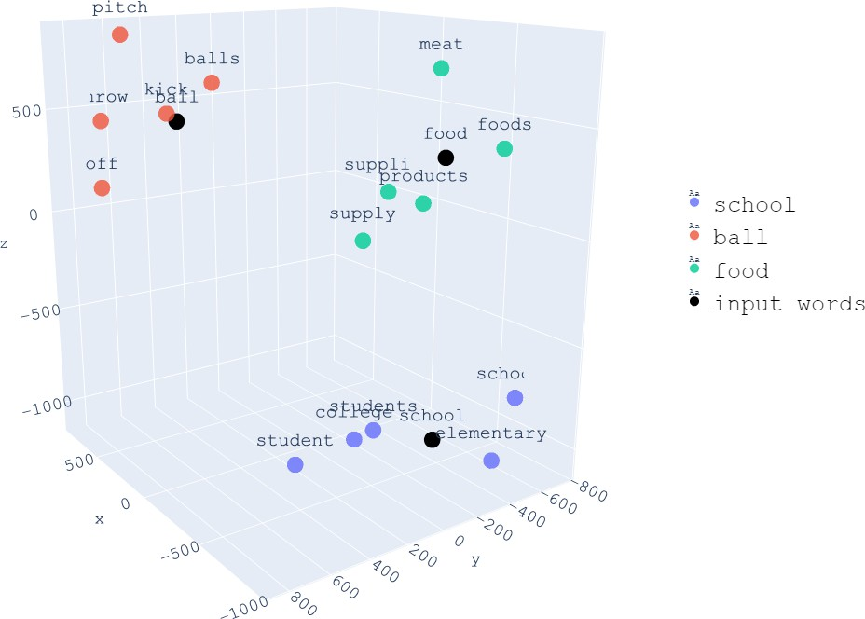

Slide 27
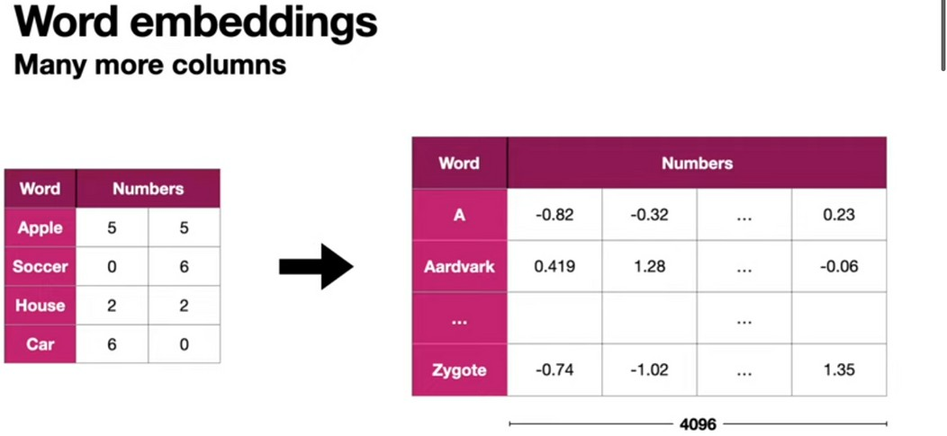

Slide 28
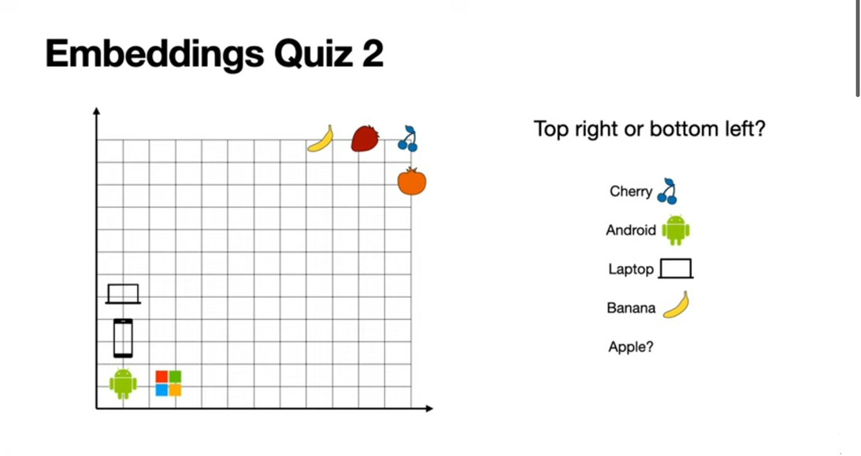

Slide 29
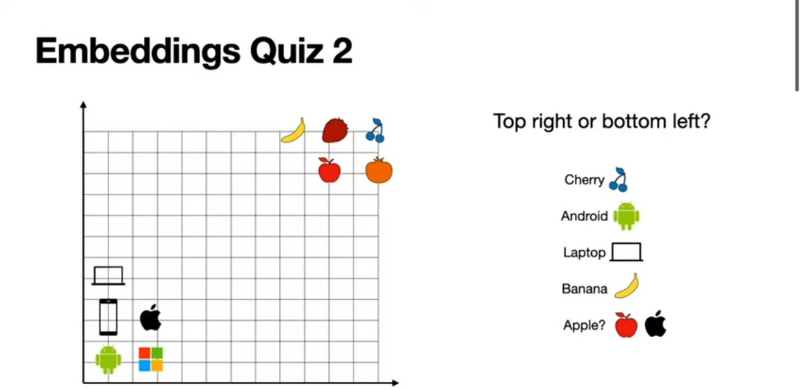

Slide 30
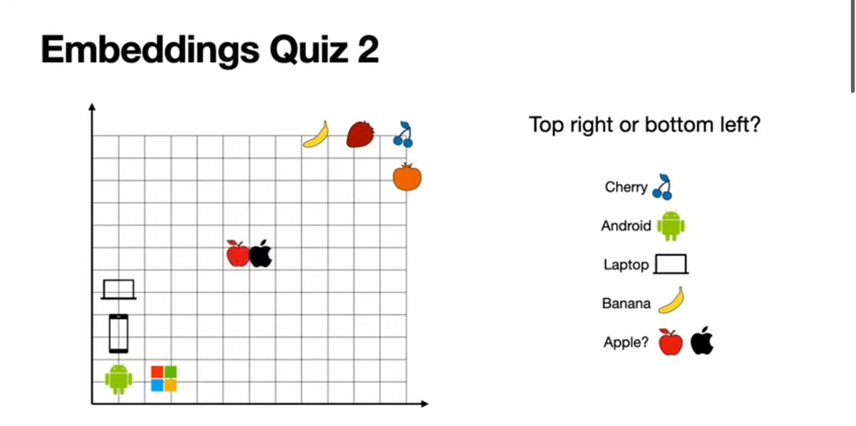
Need to identify context here.
To solve this problem: Attention Mechanism

Slide 31
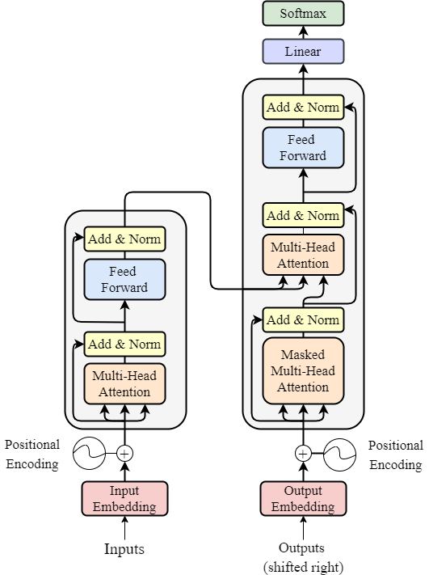
Transformer Architecture

Slide 32
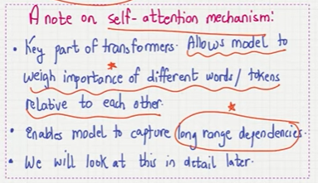

Slide 33
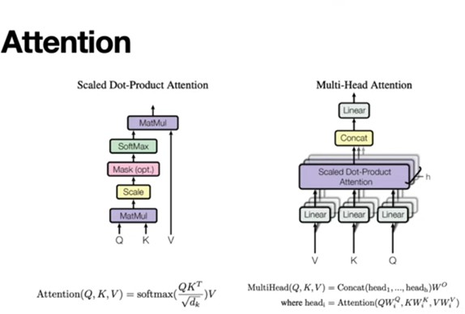

Slide 34


Slide 35
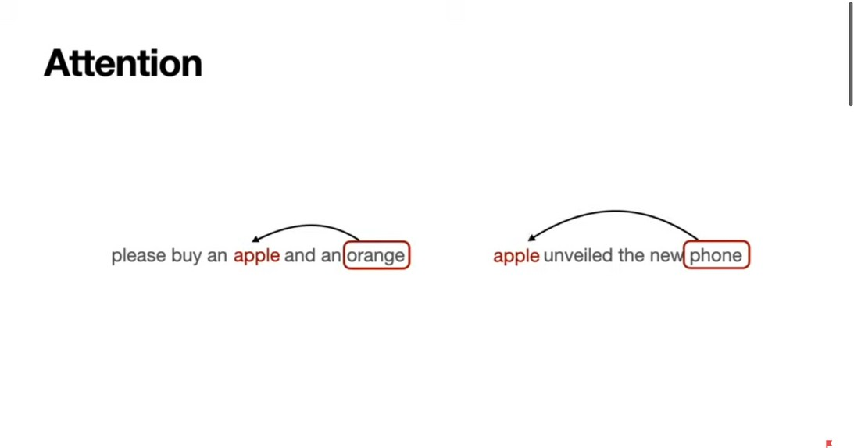

Slide 36
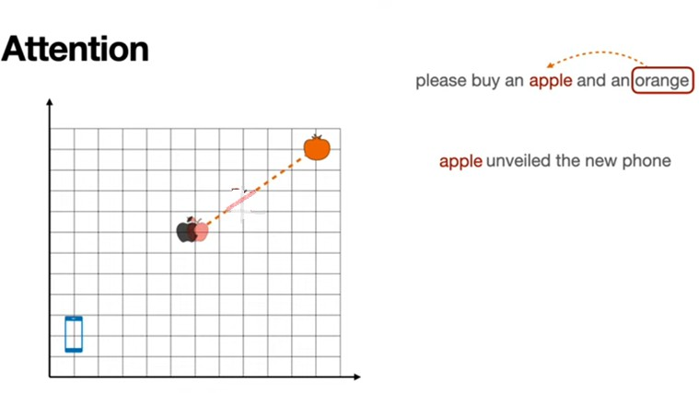

Slide 37
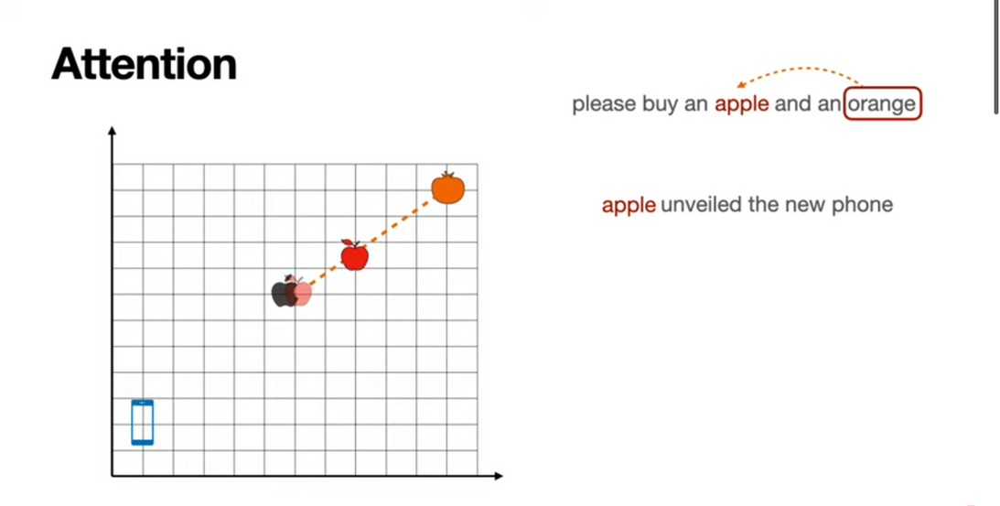

Slide 38
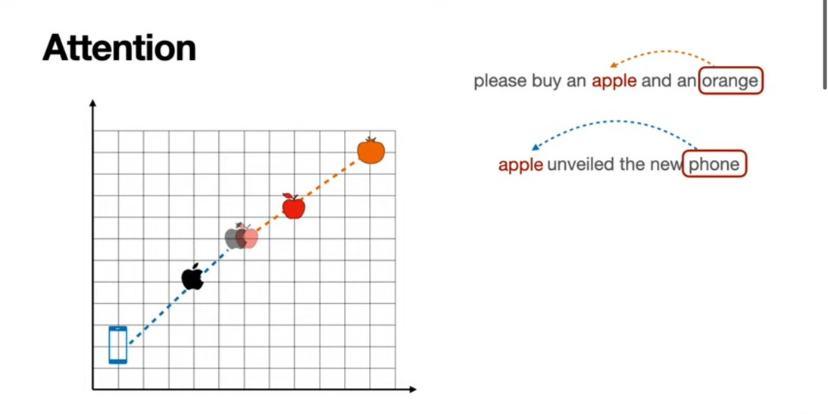

Slide 39
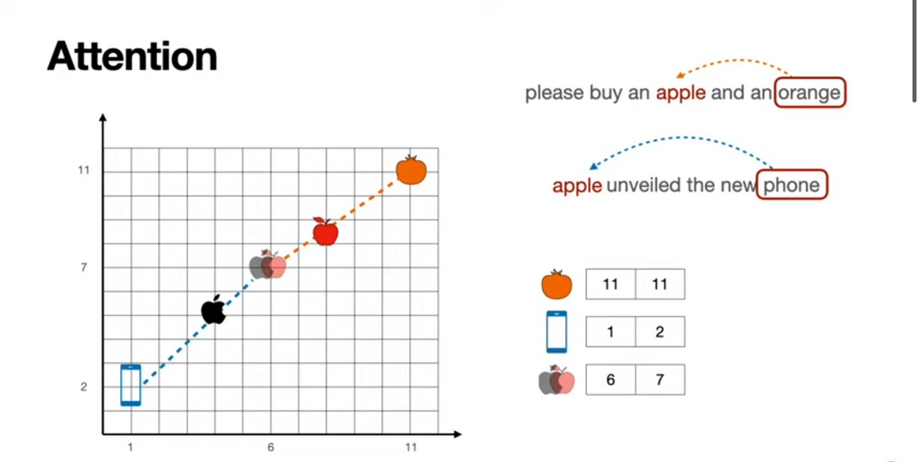

Slide 40
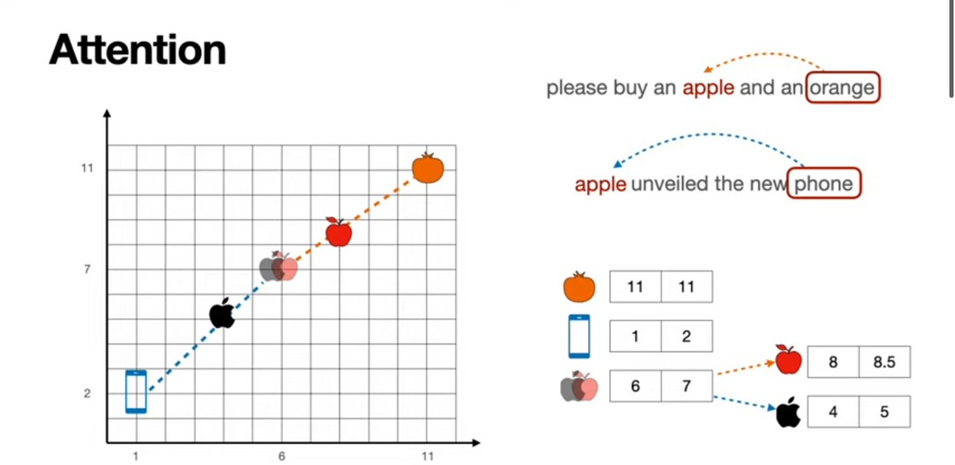

Slide 41
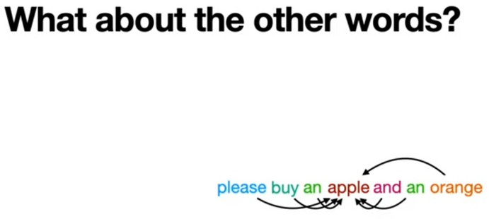

Slide 42
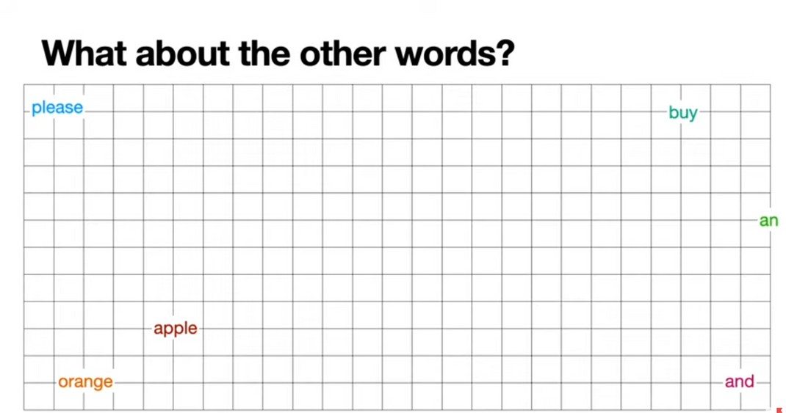

Slide 43
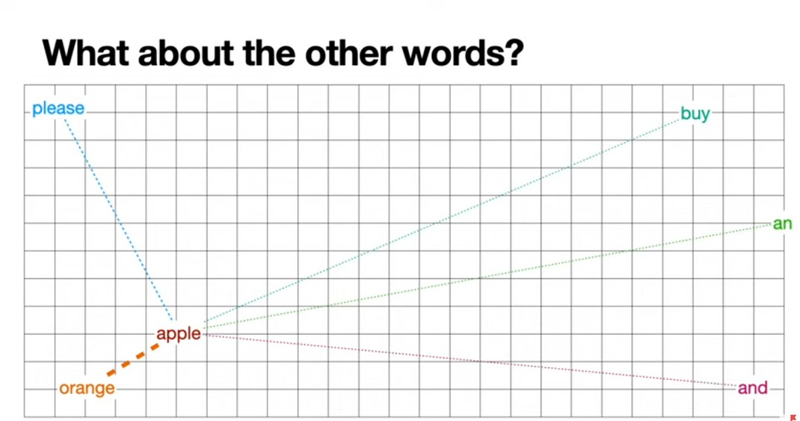

Slide 44
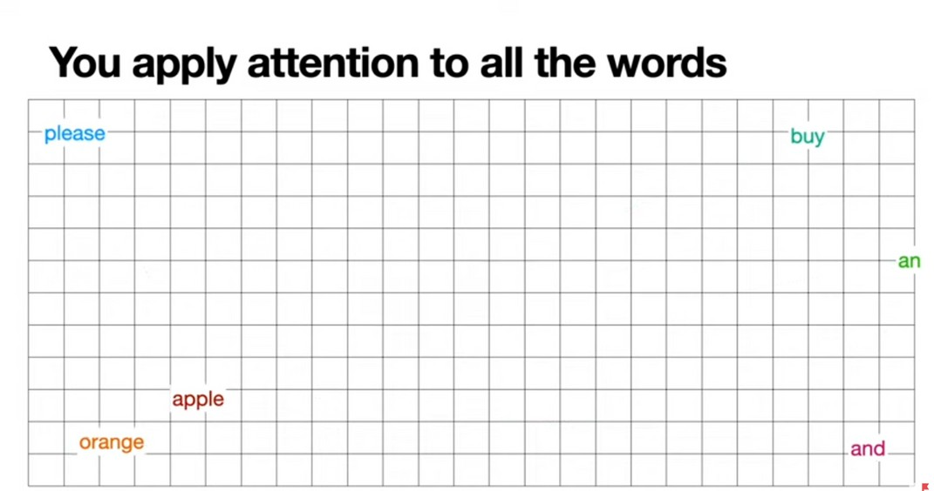

Slide 45
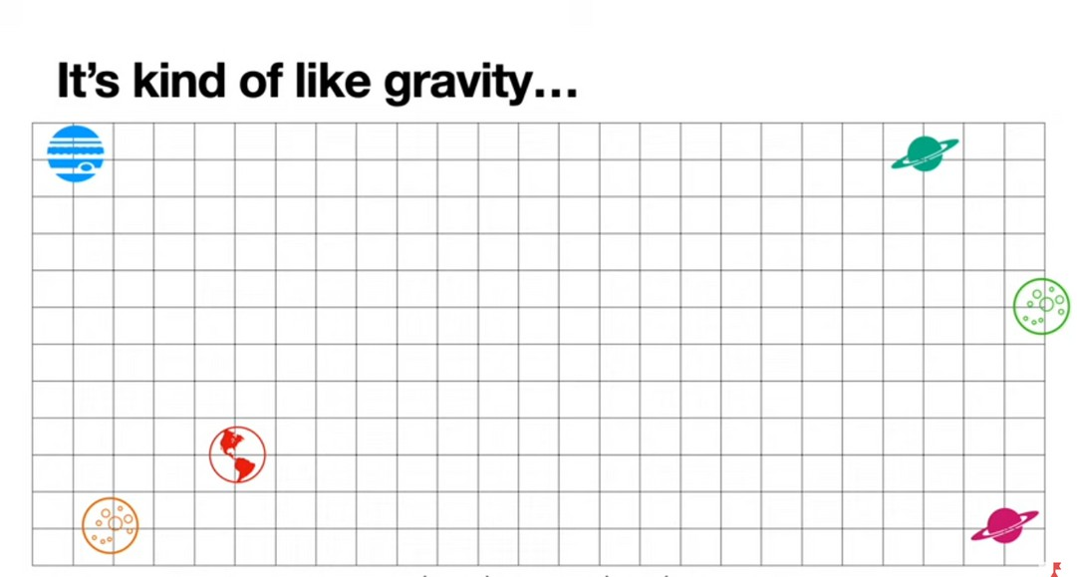

Slide 46
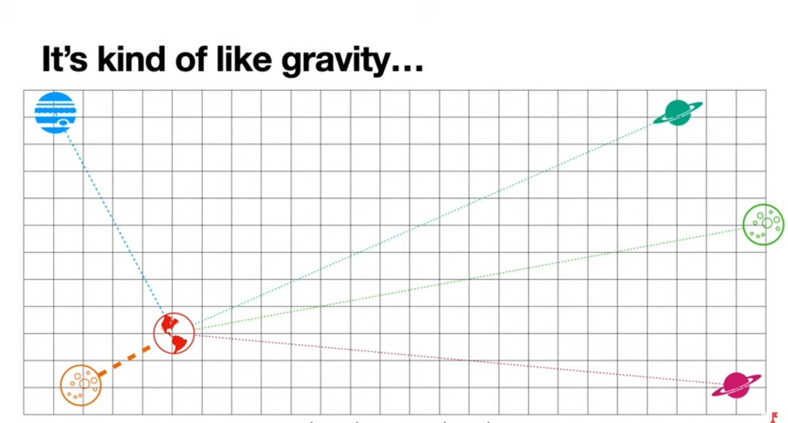

Slide 47
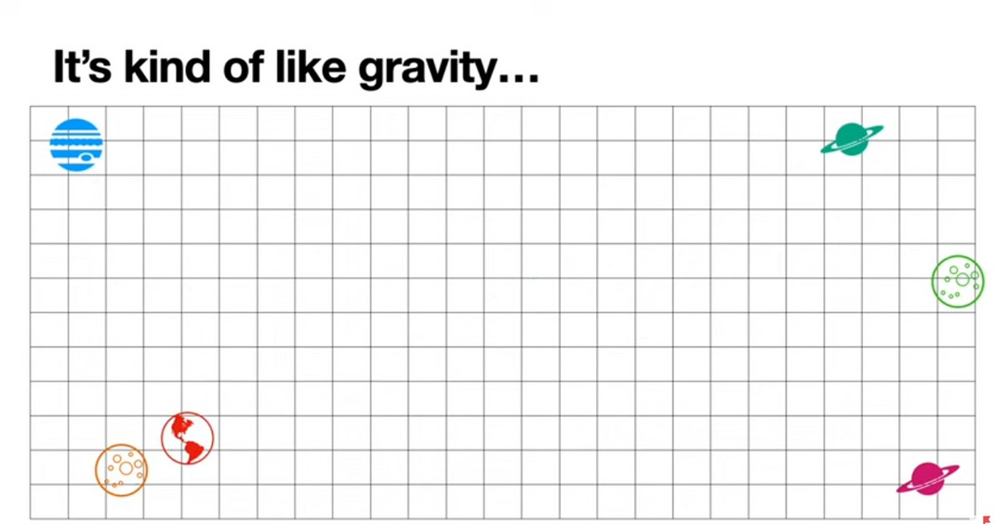

Slide 48
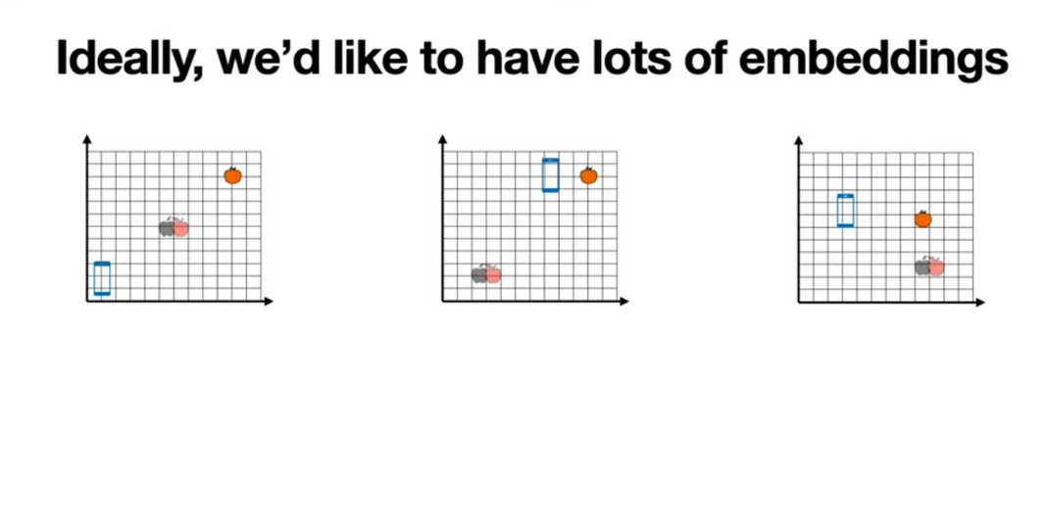

Slide 49
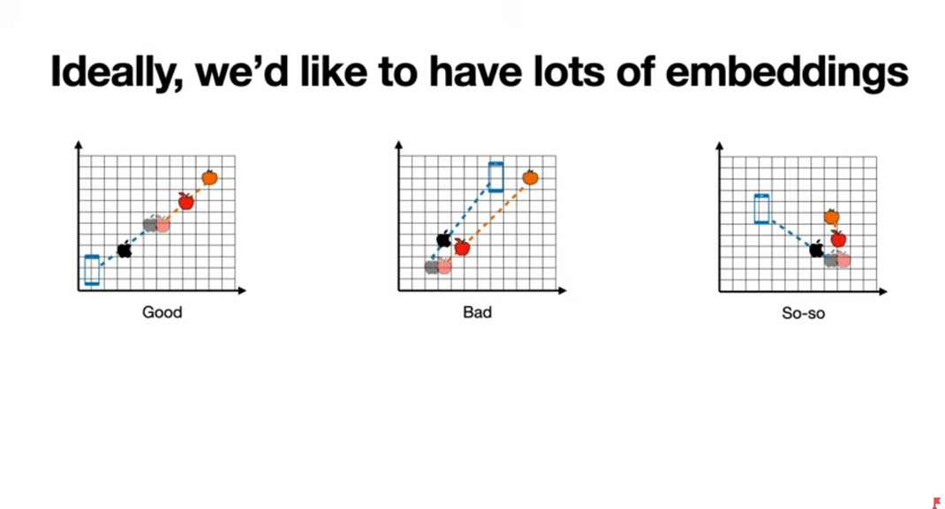

Slide 50
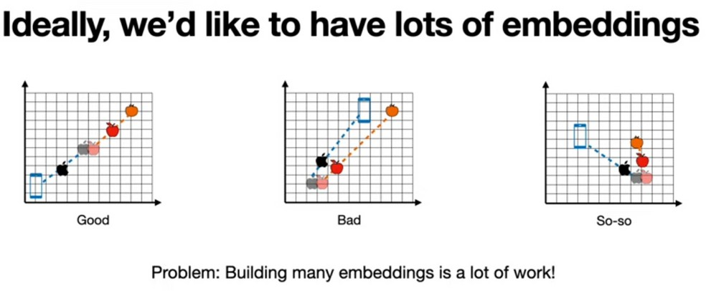

Slide 51
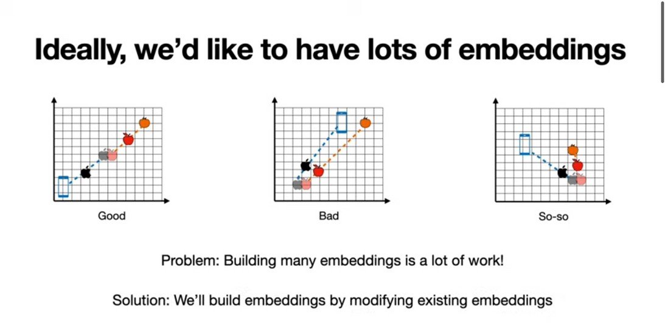

Slide 52
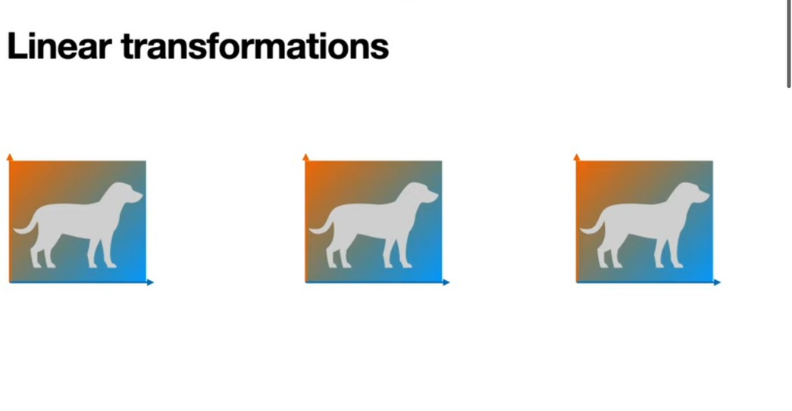

Slide 53
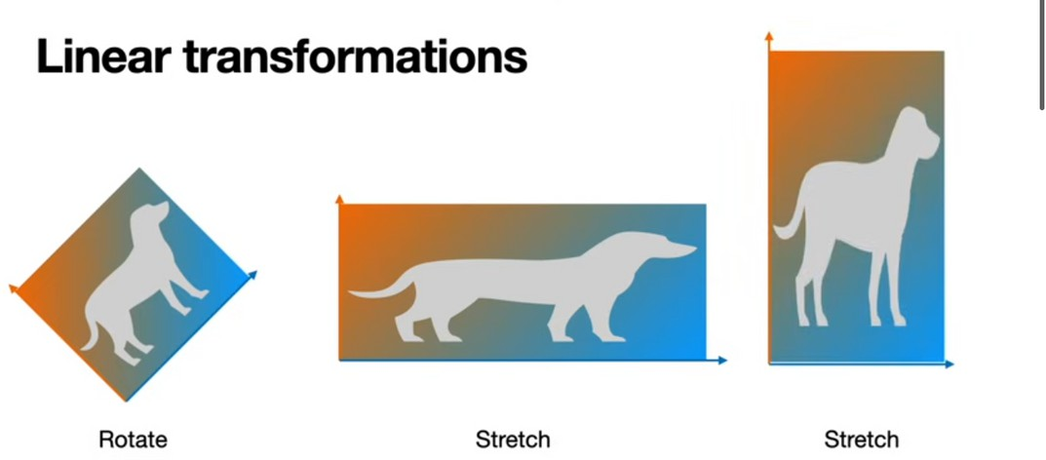

Slide 54
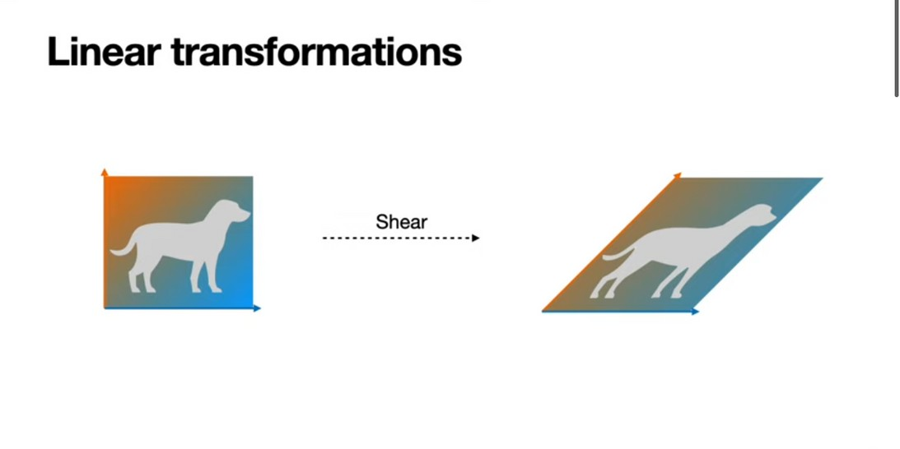

Slide 55
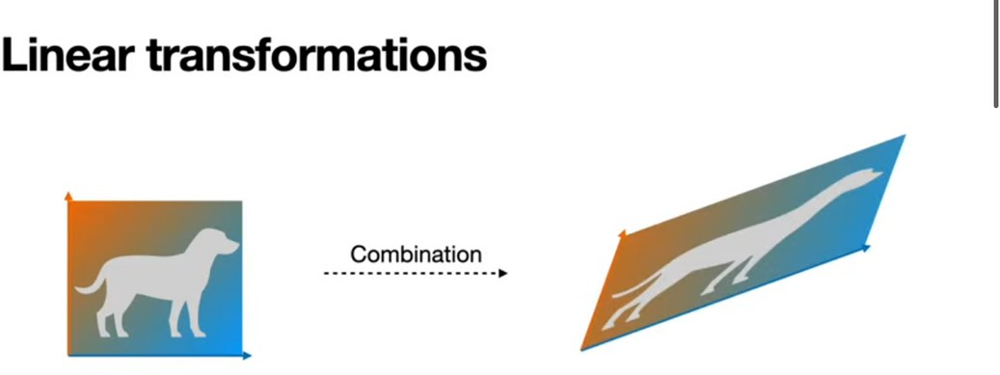

Slide 56
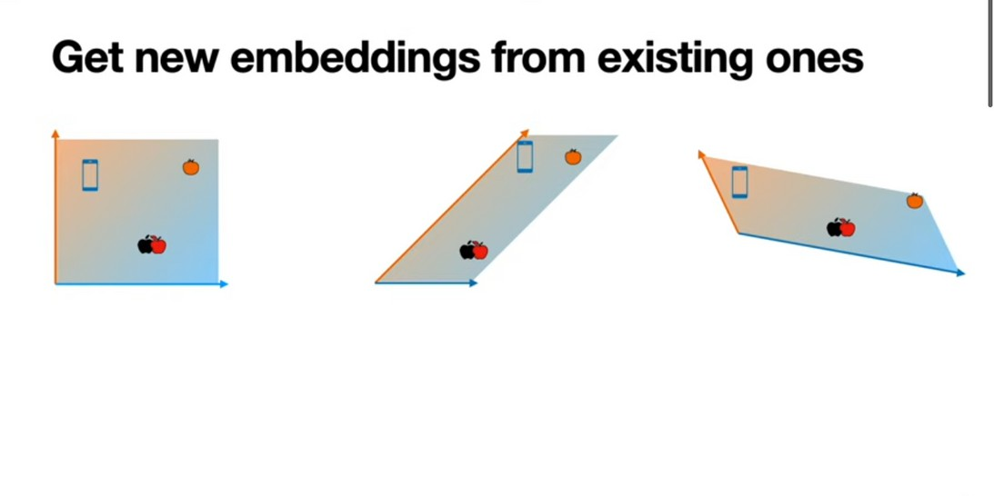

Slide 57
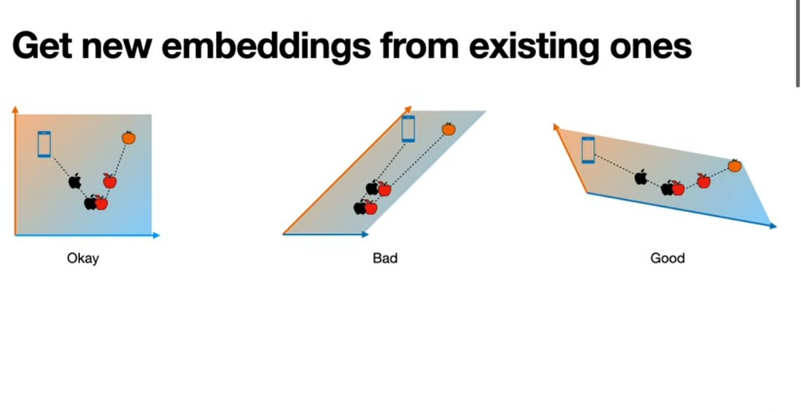

Slide 58
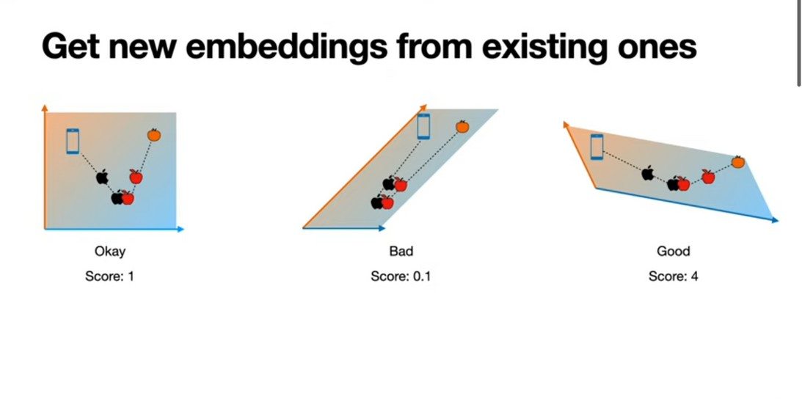

Slide 59
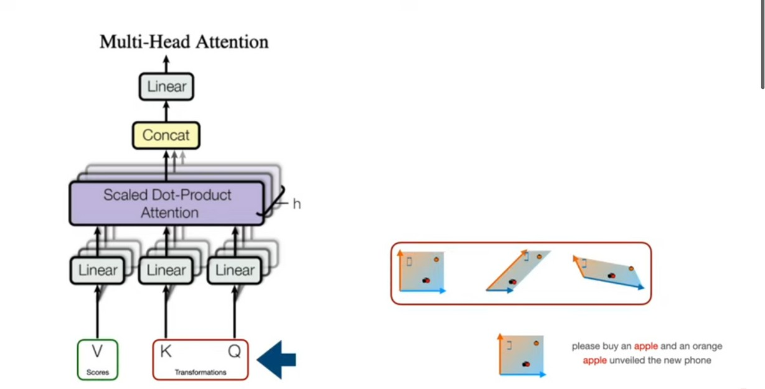
The key, query used for linear transformation.

Slide 60
Math behind Attention Mechanism
Similarity between words:
Dot Product
Cosine Similarity

Slide 61
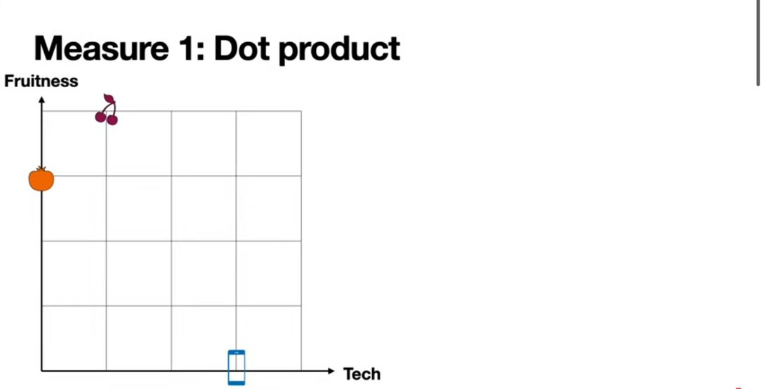

Slide 62
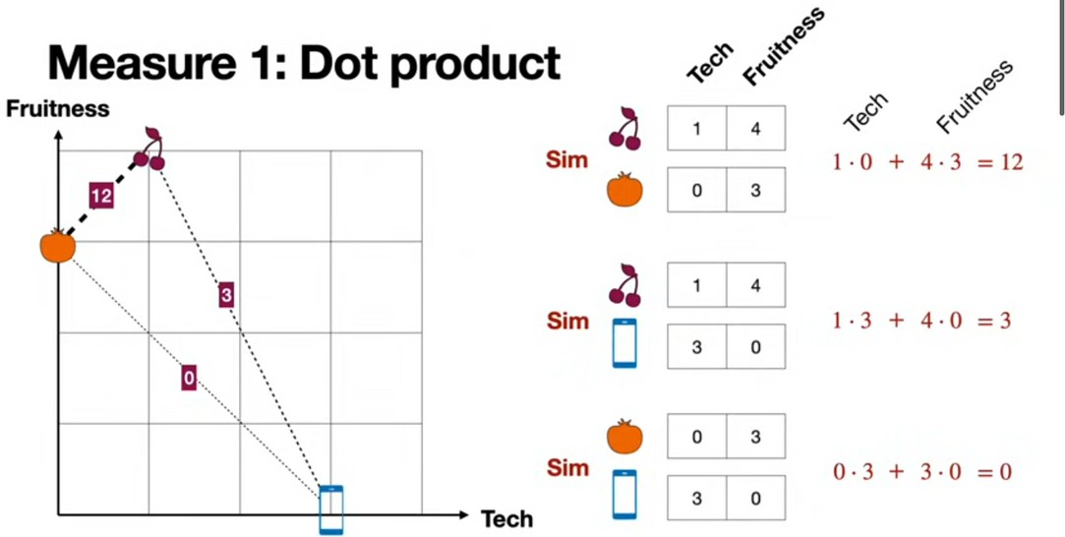

Slide 63


Slide 64


Slide 65


Slide 66


Slide 67


Slide 68


Slide 69


Slide 70


Slide 71


Slide 72


Slide 73


Slide 74


Slide 75


Slide 76


Slide 77


Slide 78


Slide 79


Slide 80


Slide 81


Slide 82


Slide 83


Slide 84


Slide 85


Slide 86


Slide 87


Slide 88


Slide 89


Slide 90


Slide 91


Slide 92


Slide 93


Slide 94


Slide 95


Slide 96



Slide 97



Slide 98


Slide 99


Slide 100


Slide 101


Slide 102


Slide 103


Slide 104



Slide 105
Each token's embedding vector is transformed into three vectors: Query (Q), Key (K), and Value (V).
These vectors are derived by multiplying the input embedding matrix with learned weight matrices for Q, K, and V.
Here's a web search analogy to help us build some intuition behind these matrices:
Query (Q) is the search text you type in the search engine bar. This is the token you want to "find more information about".

Slide 106
Key (K) is the title of each web page in the search result window. It represents the possible tokens the query can attend to.
Value (V) is the actual content of web pages shown. Once we matched the appropriate search term (Query) with the relevant results (Key), we want to get the content (Value) of the most relevant pages.
By using these QKV values, the model can calculate attention scores, which determine how much focus each token should receive when generating predictions.

Slide 107


Slide 108
Thank You

